Slide 1
Strategy Design Pattern

Slide 2
What is strategy design pattern
Strategy pattern : is a behavioral design pattern that allows the behavior of an object to be selected at runtime.
s a behavioral design pattern that allows

Slide 3
What is strategy design pattern (con..)
The Strategy pattern is based on the idea of encapsulating a family of algorithms into separate classes that implement a common interface. The pattern consists of three main components: the Context, the Strategy, and the Concrete Strategy.

Slide 4
How strategy pattern work
As we mentioned The Strategy pattern consists of three main components: the Context, the Strategy, and the Concrete Strategy
The Context is the class that contains the object whose behavior needs to be changed dynamically.
The Strategy is the interface or abstract class that defines the common methods for all the algorithms that can be used by the Context object.
The Concrete Strategy is the class that implements the Strategy interface and provides the actual implementation of the algorithm.

Slide 5
How to use strategy pattern
To use the Strategy pattern, you first create a Context object. Then, you create one or more Concrete Strategy objects that implement the Strategy interface. Finally, you set the Strategy object for the Context object by calling its setStrategy() method.
At runtime, the Context object uses the selected Concrete Strategy object to perform its operations.

Slide 6
Advantages of strategy pattern
Flexibility: The Strategy pattern allows the behavior of an object to be changed dynamically at runtime by selecting different algorithms.
Modularity: The pattern encapsulates the algorithms in separate classes, making it easy to add or remove algorithms without affecting other parts of the code.
Testability: The pattern makes it easy to test the different algorithms separately, without affecting the overall behavior of the code.
Open-Closed Principle: The Strategy pattern follows the Open-Closed Principle, which states that a class should be open for extension but closed for modification.
Note: However, the Strategy pattern can also have some drawbacks, including increased complexity due to the use of multiple classes, and potential performance issues if the selection of algorithms is done frequently at runtime.

Slide 7
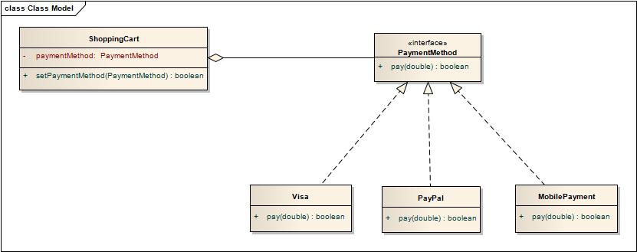
Strategy pattern class digram

Slide 8
Tree components of strategy pattern
In the next slides I will show the main 3 components of strategy pattern form our GYM APP Code

Slide 9
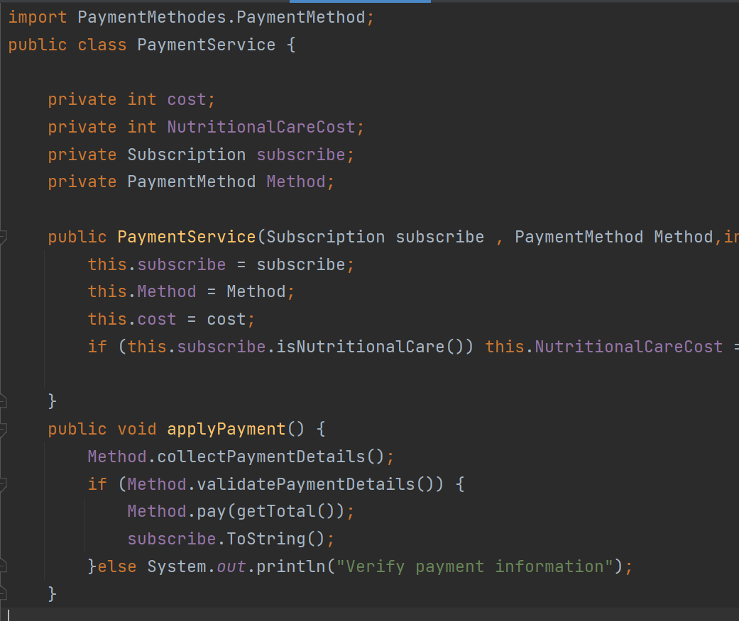
The context class

Slide 10
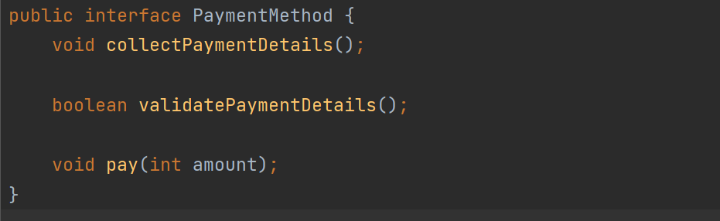
The strategy interface

Slide 11
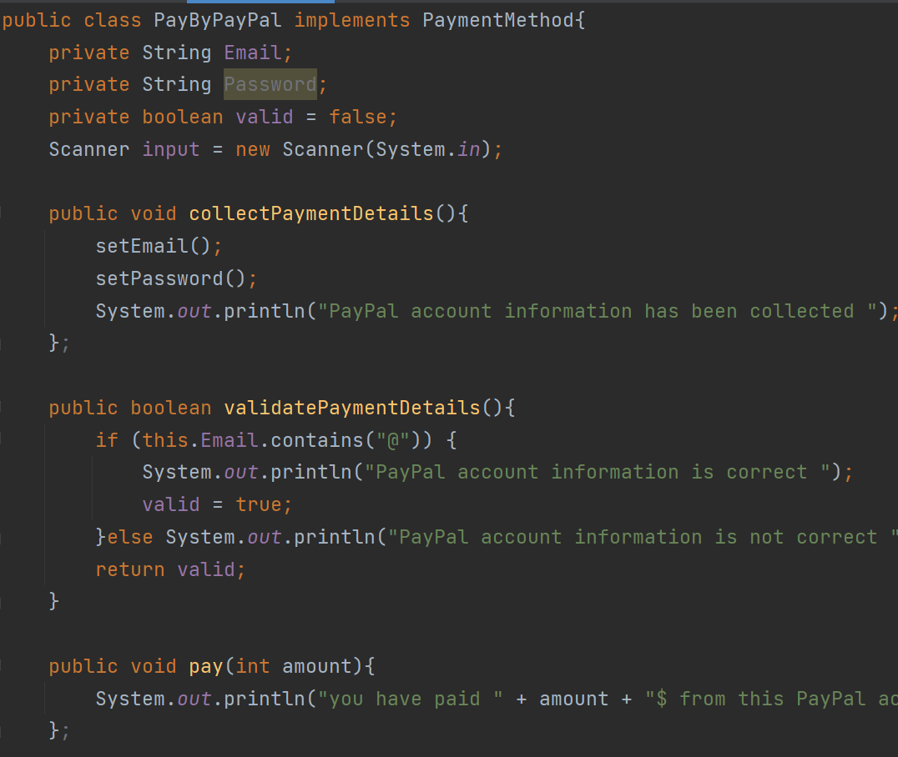
The Concrete Strategy

Slide 12
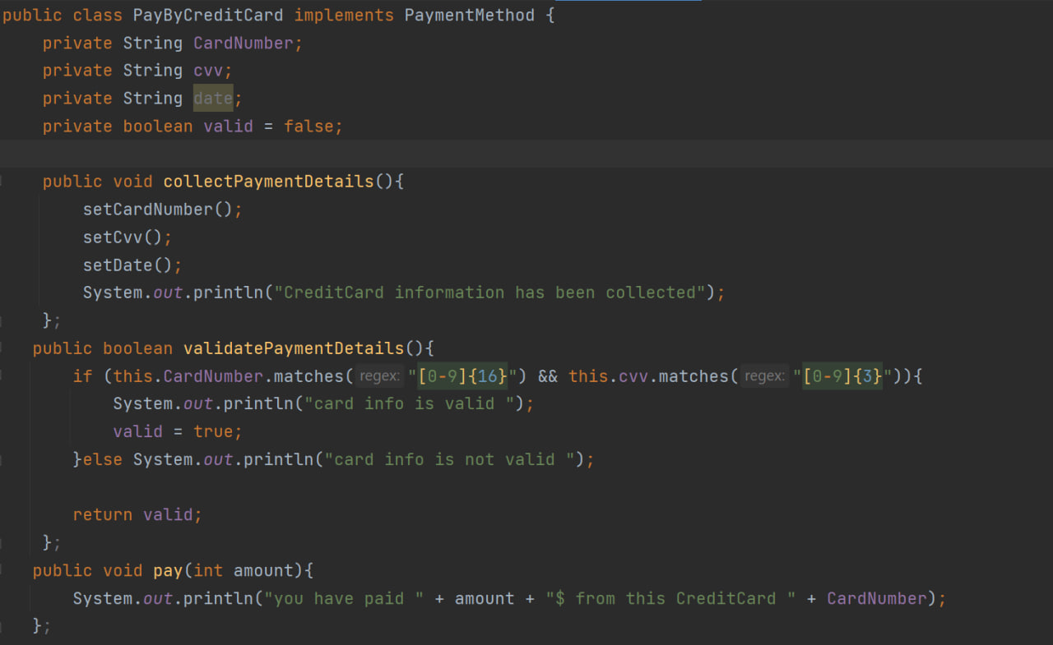
The Concrete Strategy (con…)

